Slide 1
2.8 Respiration
Understanding:
Cell respiration is the controlled release of energy from organic compounds to produce ATP
ATP from cell respiration is immediately available as a source of energy in the cell
Anaerobic cell respiration gives a small yield of ATP from glucose
Aerobic cell respiration requires oxygen and gives a large yield of ATP from glucose
Applications:
Use of anaerobic cell respiration in yeasts to produce ethanol and carbon dioxide in baking
Lactate production in humans when anaerobic respiration is used to maximise the power of muscle contractions
Skills:
Analysis of results from experiments involving measurement of respiration rates in germinating seeds or invertebrates using a respirometer
Nature of science:
Assessing the ethics of scientific research: the use of invertebrates in respirometer experiments has ethical implications

Slide 2
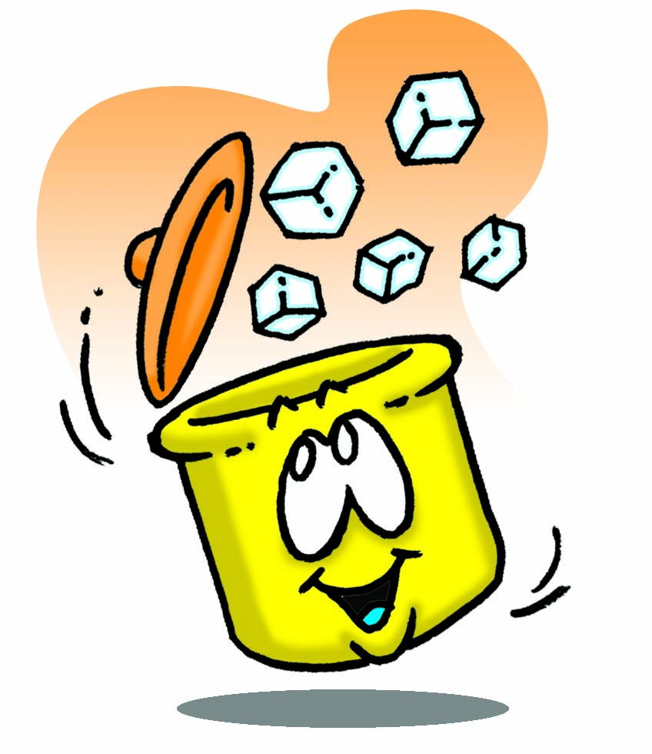
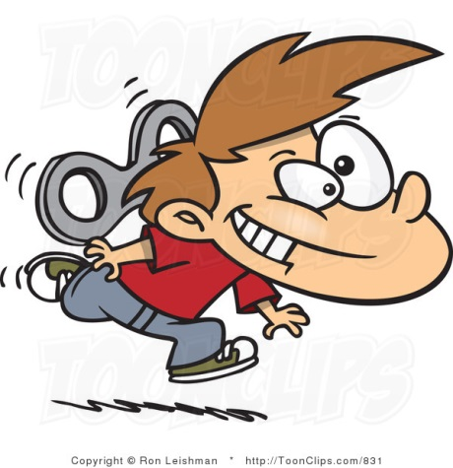
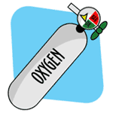
Energy
Glucose
Carbon dioxide
Water
Oxygen
Make an equation

Slide 3
Glucose
Oxygen
Carbon dioxide
Water
ATP
Energy

Slide 4
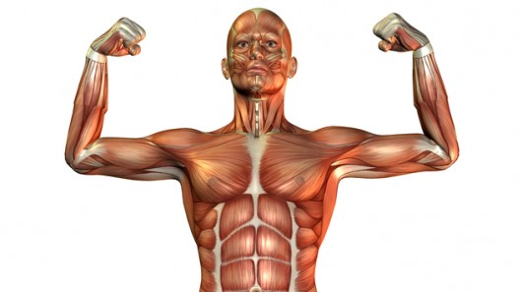
Respiration
Controlled release of energy from organic compounds to produce ATP
We’ll look at this in a minute

Slide 5
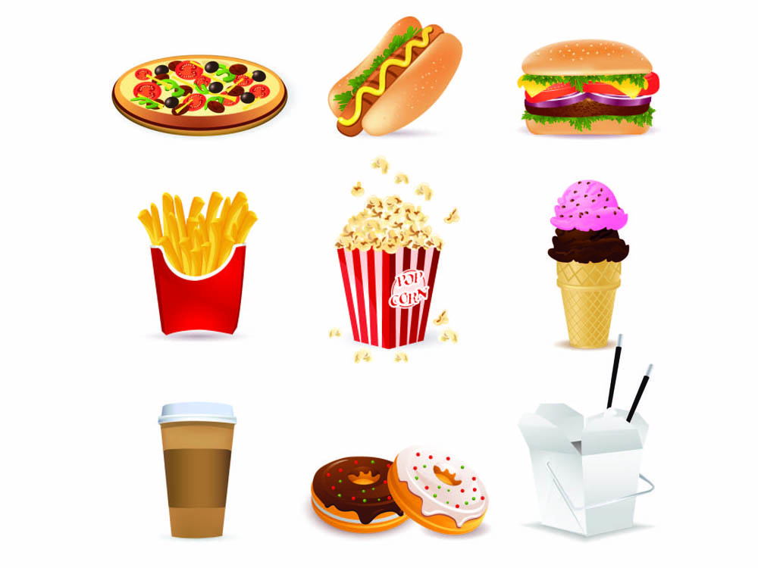
Humans
Source of organic compounds to break down comes from the food we eat
Glucose is mainly used in respiration.
Fats/lipids and even amino acids from proteins

Slide 7
(all biological processes are enzyme controlled)

Slide 8
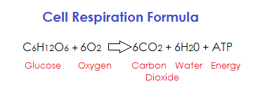
Aerobic
Glucose fully broken down
Releases a great quantity of energy
30 molecules of ATP produced per glucose molecule
The reactions of aerobic respiration occur in the cytoplasm and mitochondria

Slide 9
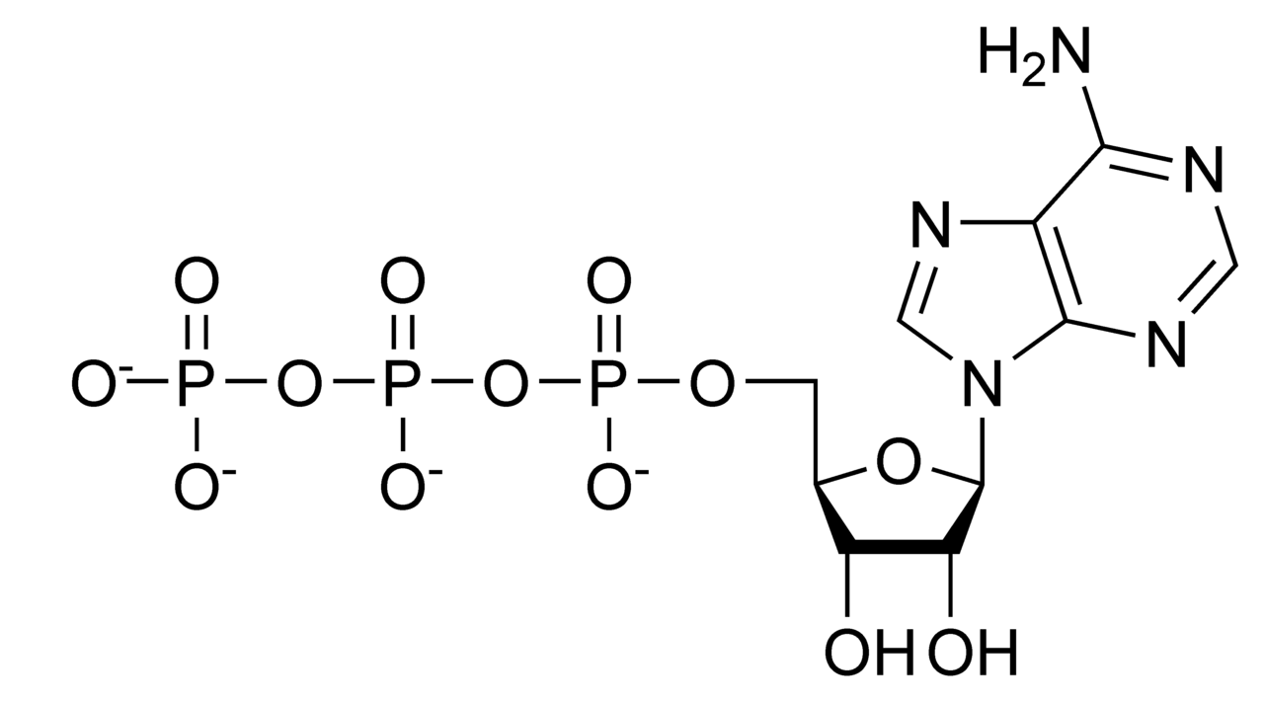
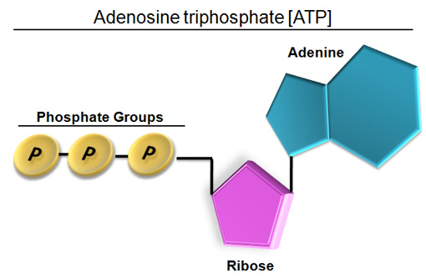
Adenosine Triphosphate (ATP)
ATP is not transferred from cell to cell – it is continuously needed and produced in each cell to carry out their functions

Slide 10
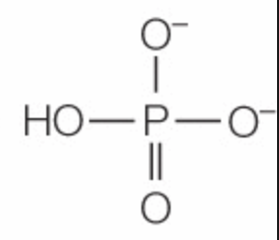
When ATP is broken down energy is released
+
Respiration makes ATP from ADP and P

Slide 11
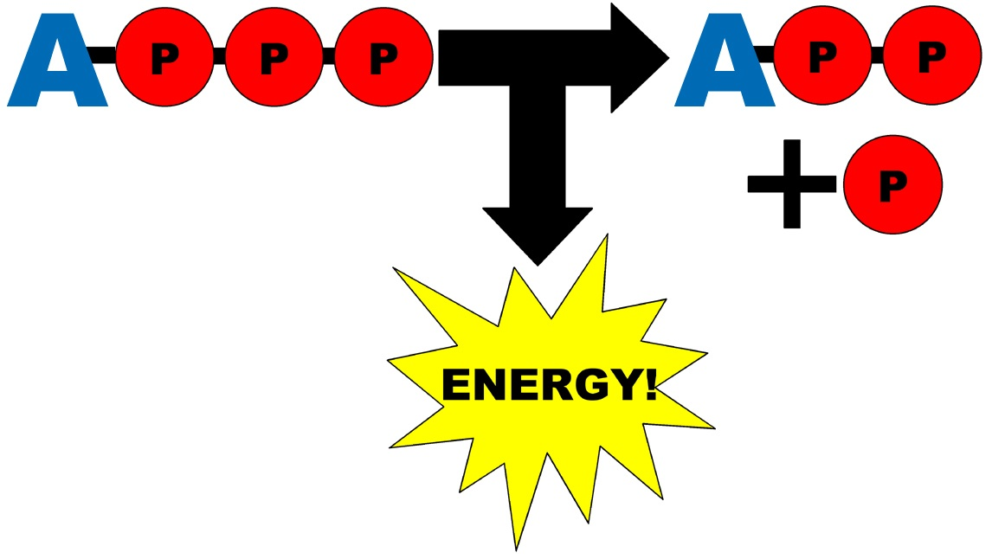
A lot of heat energy is released
Q: Why does a mouse have a higher heart rate and breathing rate than an elephant?

Slide 12
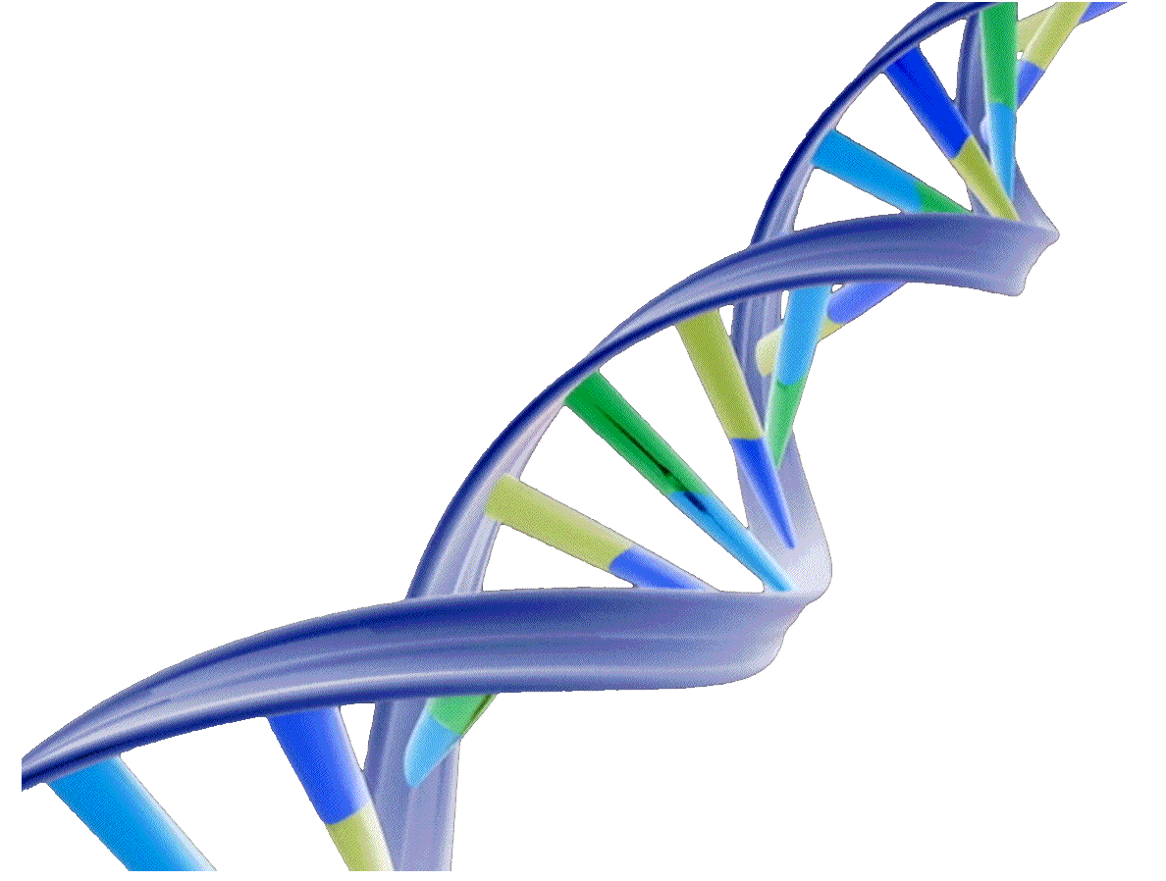
Why do cells need energy?
Three main types of activity:
Synthesising large molecules (DNA, RNA, proteins)
Pumping molecules across membranes by active transport
Moving things around inside the cell (vesicles, chromosomes)

Slide 13
Respirometers: Practical
How could we measure the rate of reaction?
We will be measuring the respiration rate of maggots.

Slide 14
Anaerobic
No oxygen used to break down glucose
Yield of ATP small
2 molecules of ATP per glucose molecule
Short rapid burst of ATP needed
Oxygen supplies run out in cells
Environment is deficient in oxygen (waterlogged soils) or breathing rates can’t keep up with demand

Slide 15
Animals
2 ATP
Yeast and Plants
2 ATP

Slide 16
Compare anaerobic and aerobic respiration in humans (4)
Both produce ATP
Aerobic produces more than 30 molecules of ATP whereas anaerobic produces 2 molecules of ATP
Aerobic respiration produces more energy than anaerobic respiration
Aerobic respiration requires oxygen whereas anaerobic respiration does not require oxygen
Aerobic respiration produces carbon dioxide and water whereas anaerobic respiration produces lactic acid

Slide 17
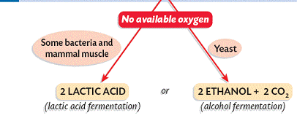
Anaerobic Respiration
Glucose is broken down without oxygen
GLUCOSE
Both toxic in excess so must be removed

Slide 18
Mummy, please explain the science of bread rising to me

Slide 19
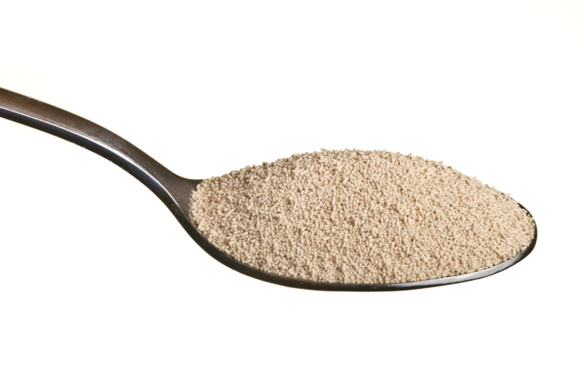
Yeast
Research the uses of yeast:
What is yeast?
Does it respire aerobically or anaerobically or both?
How is yeast used in baking? (Refer to carbon dioxide and ethanol production)
What is bioethanol?
What is it used for?
How is it produced?

Slide 20
Data Q pg 125

Slide 21
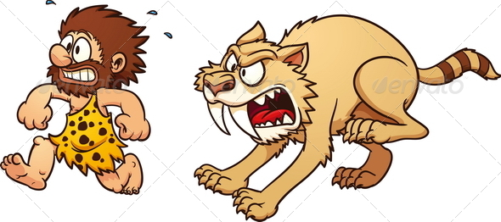
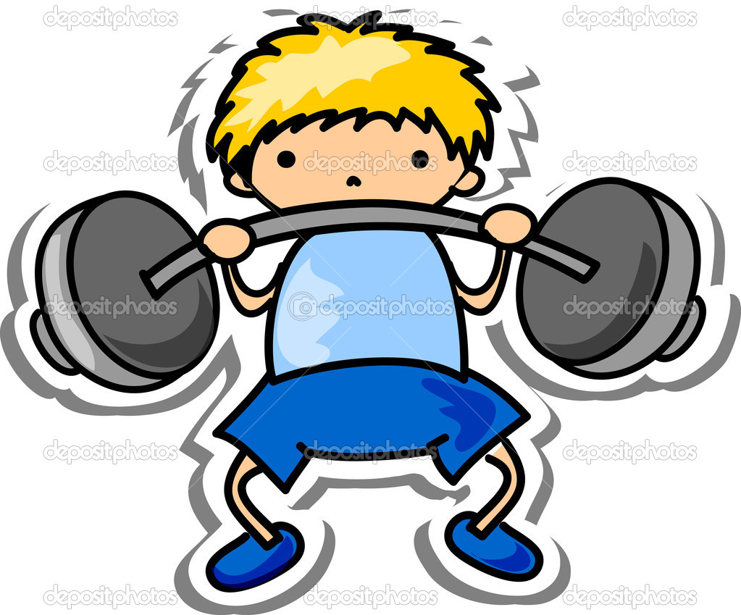
Evolution of anaerobic respiration
Ancestors would need to escape predators quickly
Chasing animals for food
Need a short burst of ATP
Those that are better – survive and reproduce
Now mainly used in sport

